Slide 1
Angular 4 .NET Developers
01 Mar 18 | Start
12 May 18 | 1: 3-49
12 May 18 | 2: 50-54
Appendix
Online

Slide 2
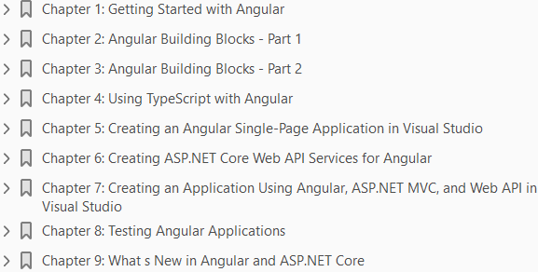
Angular 4 - .NET
Ch | Date
1 | 14-Apr-18
2
3
4
5
6
7
8
9
Learning Angular for .NET Developers 06 2017

Slide 3
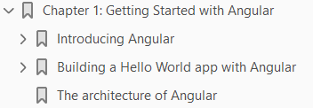
1
Getting Started with Angular

Slide 4
Intro
If you are reading this book, it is because you are a .NET developer and would like to learn how to use Angular with the .NET Framework technologies such as
ASP.NET Model View Controller (MVC)
Web API
legacy technologies such as
web forms
web services
It enables the developer to develop richer and dynamic .NET web applications powered by Angular.
Angular is an open source JavaScript framework that helps create dynamic web applications.
In this chapter, we will cover the following topics:
Introducing Angular
The Angular architecture
Building a Hello World app with Angular

Slide 5
Introducing Angular
Let’s understand the history of AngularJS before getting into Angular.
It all started with improving the development process of client-side web.
As part of the improvement, Microsoft introduced the XML HTTP request object to retrieve data from the server.
As the advanced JavaScript libraries such as jQuery and Prototype were introduced, developers started using Ajax to asynchronously request data from the server.
These libraries were extensively used to manipulate the DOM and bind data to a UI in the late 90s.
Ajax can enable web applications to send data to or retrieve data from a server asynchronously without interfering with the display and behavior of the page
Ajax allows web applications to change content dynamically, without reloading the full page by decoupling the data interchange layer from the presentation layer.
In late 2010, two JavaScript MVC frameworks were introduced: backbone and knockout.

Slide 6
Introducing Angular |
Backbone provided a complete Model-View-Controller experience, whereas knockout mainly focused on binding using the MVVM pattern.
With the release of these frameworks, people started believing in the power of client-side MVC frameworks.

Slide 7
The Birth of AngularJS
A developer from Google felt that there was one major part missing in the client-side MVC frameworks that existed in the market, that is, testability.
He felt that there was a better way to implement client-side MVC, and this made him start his journey to build Angular.
Google supported the Angular project, seeing its potential, and made it open source for the world to use it for free.
Angular created a lot of awareness among all the MVC frameworks in the market as it was backed by Google and also due to its features, such as
Testability
Directives
Today, the Angular team has grown from a single developer to a large number of developers, and it has become the first choice to add the power of client-side MVC to small, medium, or big web applications.

Slide 8
Why AngularJS?
The benefit or value addition that our application can get by using AngularJS:
AngularJS provides two-way binding:
Many client-side MVC frameworks provide only one-way binding.
This means that other MVC frameworks will update HTML with the model from the server, and when the user changes the model on the page, the frameworks will not update the model according to the changes made.
A developer has to write code to update the model according to the user action.
However, AngularJS facilitates two-way binding and has made the life of developers easier by updating the model as per the user's actions on it.
AngularJS utilizes declarative views:
This means that the functionalities will be communicated as declarative directions in HTML to render the models and interact with the DOM to change the page state based on changes in the model.
This extensively reduces the code by about 50% to 75% for this purpose and makes the life of developers easier.

Slide 9
Why AngularJS? |
AngularJS supports the directive concept:
This is like writing a domain-specific language for the web application.
Directives will extend the functionality of HTML and render them dynamically according to the changes in the application rather than just displaying the HTML page.
AngularJS is highly testable:
As said earlier, one of the main mottos of the development of Angular is to introduce a testable client-side MVC framework.
AngularJS is highly testable, and in fact, the Angular team has introduced two frameworks: Karma and Protractor, to write end-to-end unit testing to ensure the stability of the code and to enable the refactoring of the code confidently.

Slide 10
Angular 2
Since the first release of AngularJS in Oct 2010, a lot of things that have changed in the web world.
To accommodate all these modern happenings in AngularJS, it would have to undergo many changes in the existing implementation, and this made the Angular team write AngularJS from scratch.
At the ngEurope conference held in October 2014, Angular 2 was announced as a massive update to Angular 1 for building complex web applications.
The ngCommunity was a little upset as they invested a lot of time in learning and implementing Angular 1, and now they had to redo the process of learning and implementing Angular again.
However, Google invested a lot in the migration and upgrade process from Angular 1 to 2 by introducing ngUpgrade and ngForward.
Once the developers started learning and building products in Angular 2, they realized the power of cleaner, faster, and easier Angular 2.
Angular 2 was rewritten from scratch. It helped us write clean and testable code that can run on any device and platform. Angular 2 eliminated many concepts from Angular 1.

Slide 11
Angular 2 |
Angular 2 follows the standardization of ECMAScript 2015.
With the recent web standardization
the shadow DOM replaced transclusion
the ECMAScript 6 modules replaced Angular modules
Angular 2 is five times faster than Angular 1.x.

Slide 12
The benefits of Angular 2
The following are the features and benefits of Angular 2:
It supports cross-platform application development, such as high performing apps like
web apps
native apps using Ionic Framework
NativeScript
React Native
creating desktop-installed apps by accessing native OS APIs
using Angular methods.
Angular 2 inherits all the benefits of Angular 1.
It replaced controllers and directives with components.
Angular 2 was written in TypeScript and also, it enabled developers to write Angular 2 applications using TypeScript.
Angular 2 is significantly faster than Angular 1. The new component router only loads code required to render a view that is requested.

Slide 13
The benefits of Angular 2 |
The template syntax enables a developer to quickly create views with the powerful template syntax.
Angular 2 enables us to use shadow Document Object Model (DOM).
Shadow DOM encapsulates CSS, template, and the component.
This enables decoupling from the DOM of the main document.
It is the simpler cognitive model.
A lot of directives were removed in Angular 2 and this means that Angular 2 has fewer pieces and fewer moving parts so that it is easier to build larger applications with Angular 2 than with Angular 1.

Slide 14
The development process in Angular 2
Angular 2 has two development processes, namely, the following:
With a transpiler
Without a transpiler

Slide 15
What is ECMAScript 6?
ES6 is the latest version of scripting language specification.
It is a JavaScript language used on the world wide web for client-side scripting.
ECMAScript 6 is a great update to JavaScript language and the process of implementation of these features in JavaScript engine is in progress.

Slide 16
What is a Transpiler?
A transpiler basically converts any specific language to JavaScript.
A good example of this is the Typescript transpiler, which converts Typescript code to JavaScript.

Slide 17
What is TypeScript?
TypeScript is an open source programming language developed by Microsoft.
It is a superset of JavaScript, and it enables programmers to write object-oriented programs in JavaScript.
TypeScript is also used to develop transpiler, which converts TypeScript to JavaScript.
It is designed to develop larger applications.
TypeScript was developed as per the proposal of ECMAScript standard.
TypeScript has features such as
Classes
Modules
an arrow function syntax
as proposed in ECMAScript 6 standard.

Slide 18
The development process in JavaScript
Before discussing the development process with a transpiler, let's look at the development process specific to JavaScript to build a web app.
We will write our code in ECMAScript 5 and Deploy it to the Server.
ECMAScript 5 is the script that every browser understands today.
When a Request comes from the Browser, the server will serve the script and the browser will run it in the client side.
The Figure 1-1 shows the typical development process for JavaScript:

Slide 19
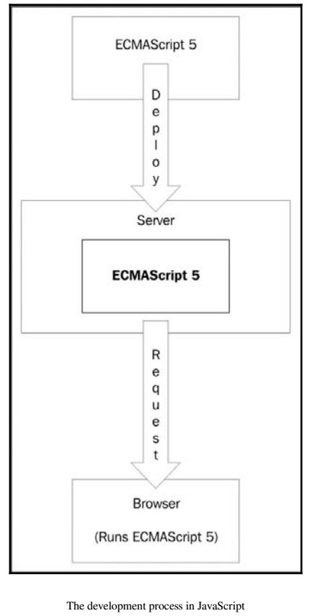
Figure 1-1

Slide 20
Development with build-time transpiler
Instead of writing scripts in the current version of JavaScript, ECMAScript 5, we can also write scripts in ECMAScript 6+ using Typescript and Transpile them into ECMAScript 5.
Then, Deploy the transpiled script to the Server, and the Browser Request will be served with the Transpiled script, which is ECMAScript 5, that is to be executed on the client side.
The benefit of this is that we can use the new features of the latest version of JavaScript or ECMAScript.
Consider Figure 1-2.

Slide 21
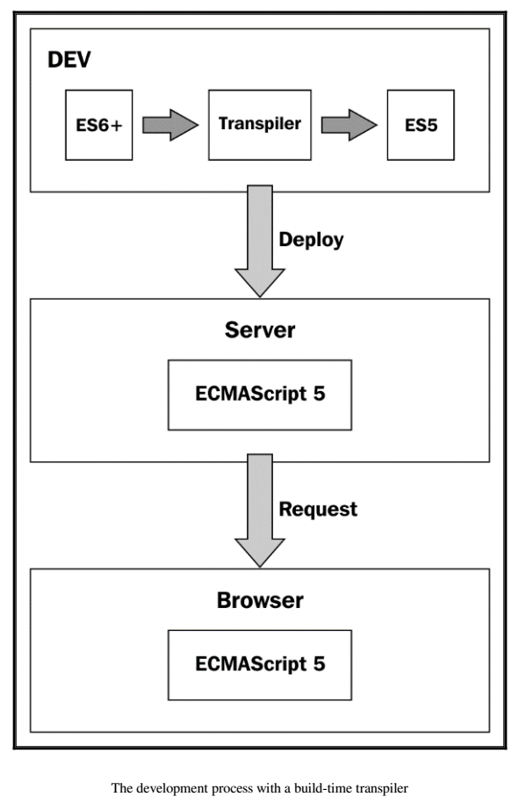
Figure 1-2

Slide 22
Development with Runtime Transpiler
There is another development option called runtime transpiler.
In this case, we start off by writing scripts in ECMAScript 6+ using Typescript or CoffeeScript and then Deploy the scripts to the Server.
When a Request comes to the Server, it simply serves ECMAScript 6+ code without Transpiling to the Browser.
Then, the browser Transpiles the scripts to ECMAScript 5 using a runtime transpiler to execute it in the client side.
This type of option is not good for production applications as it puts extra load on the browser.
Consider Figure 1-3.

Slide 23
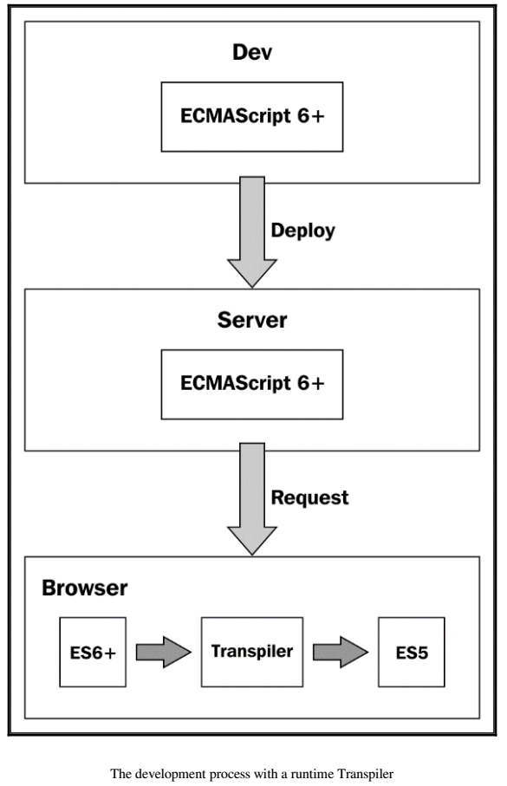
Figure 1-3

Slide 24
Transpiler Options
In Angular 2, we have two options-
to use a transpiler or
to not use a transpiler
The following are a few types of transpilers that are available:
Traceur: It is the most popular transpiler by Google, and it can be used both in build-time mode and runtime mode.
Babel: This transpiler works on the most latest version of ECMAScript.
Typescript: This is one of the most popular and preferred transpiler for Angular.
The Angular team collaborated with the Typescript team and they have worked together to build Angular 2.

Slide 25
What happened to Angular 3?
After the release of Angular 2, the team decided to go with semantic versioning.
Semantic versioning follows three number versioning, representing
Major
Minor
Patch
Patch version is the last number in the version that will be incremented for every patch release, usually bug fixes.
Minor version is the middle number in the version that deals with the release of new features or enhancements.
Finally, the major version is the first number in the version that is incremented for the release with breaking changes.
Angular team switched to use TypeScript 2.2 from TypeScript 1.8 that is used in Angular 2.
This introduces some breaking change that obviously leads to increment the major version number.

Slide 26
What happened to Angular 3? |
Also, the current version of router module is 3.3.0, which is not in alignment with the other modules of Angular that are still in 2.3.0.
So, in order to keep all the module versions in sync and follow semantic versioning, the Angular team decided to go with Angular instead of Angular 3 for their next major release.

Slide 27
What’s new in Angular?
The following are the new features in Angular:
TyepScript 2.1+ is the required scripting language for Angular.
Ahead of Time compilation mode enables Angular to compile the templates and generates JavaScript code during the build process.
This helps us identify the errors in templates during the build-time rather than at runtime.
Angular animation has its own package, and it means that you don't need to ship animation packages to the projects that don't need animation.
Template tag is now deprecated as it leads to confusion with the template HTML tag that is used in web components.
So, ng-template is introduced for templates in Angular.
Apart from these, other new features have been introduced in code level.

Slide 28
Why Angular for .NET developers?
The complexity of writing client-side code using JavaScript in .NET web applications kept increasing in scenarios such as
data-binding
server calls
validations
.NET developers faced difficulties in writing client-side validations using JavaScript.
So, they discovered and started using jQuery plugins for validations and mostly, just to change the views according to user actions.
In the later stages, .NET developers were looked after by JavaScript libraries that ensure the structure of the code and provide good features to simplify the client-side code.
Then, they ended up using a few client-side MVC frameworks in the market.
However, they only used the MVC frameworks to communicate with the server and to update views.
The trend of SPA (Single Page Applications) came into picture in the web development scenario.
These kinds of applications will be served with an initial page, possibly in a layout view or master view.

Slide 29
Why Angular for .NET developers? |
Then, the other views will be loaded onto the master view as and when requested.
This scenario will be achieved by implementing client-side routing so that the client will request a small part of the view rather than the entire view from the server.
Achieving these steps created more complexities in client-side development.
AngularJS came as a life saver for .NET developers by enabling them to reduce their efforts in performing client-side development of handling applications, such as SPA.
Data binding is the coolest feature of Angular that enables the developer to concentrate on other parts of the application instead of writing huge code to handle
data binding
Traversing
Manipulating
Listening to the DOM
The templates in Angular are simple plain HTML strings that will be parsed into DOM by the browser
the Angular compiler traverses the DOM to data bind and render instructions.

Slide 30
Why Angular for .NET developers? ||
Angular enables us to create custom HTML tags and extend the behavior of the existing elements of DOM.
With the built-in support to dependency injection, Angular resolves dependent parameters by providing their instances implicitly.

Slide 31
Building a Hello World app with Angular
Before we start building our first Angular application, let's set up the development environment to get started with Angular apps.

Slide 32
Setting up Dev Env for Angular
The first thing to do before writing any code is to set up the local development environment
We need an editor to write the code
a local server to run the application
package managers to manage the external libraries
compilers to compile the code, and so on

Slide 33
Installing Visual Studio Code
Visual Studio Code is one of the greatest editors used to write Angular applications.
Navigate to https://code.visualstudio.com/ and click on Download Code for Windows (Figure 1-4).
Visual Studio Code is an open source and cross-platform editor that supports Windows, Linux, and OS X.
It is one of the powerful text editors that includes features such as
Navigation
keyboard support with customizable bindings
syntax highlighting
bracket matching
auto indentation
Snippets
with support for many programming languages.
It has built-in support to IntelliSense code completion, richer semantic code understanding and navigation, and code refactoring.
It provides a streamlined, integrated debugging experience, with support for Node.js debugging.

Slide 34
Installing Visual Studio Code |
It is a lighter version of Visual Studio. It doesn't contain any built-in development server, such as IIS Express.
However, it is very important to test a web application in a local web server as part of the development process.
There are several ways available in the market to set up a local web server.
However, I chose lite-server as it is a lightweight, development-only node server that serves the static content, detects changes, refreshes the browser, and offers many customizations.
Lite-server is available as an NPM package for Node.js.

Slide 35
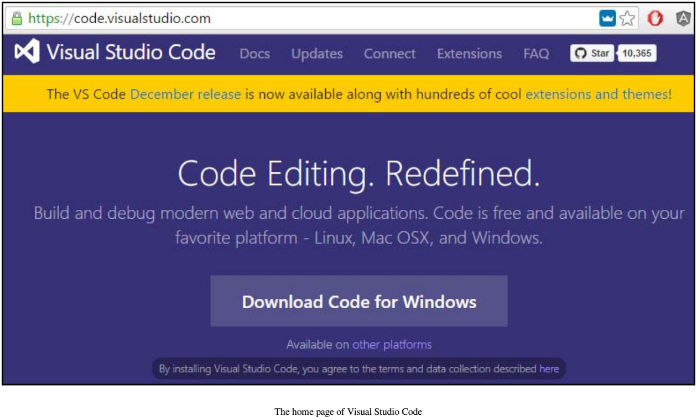
Figure 1-4

Slide 36
Installing Node.js
Node.js is used to develop server-side web applications.
It is an open source and cross-platform runtime environment.
The built-in libraries in Node.js allow applications to act as a standalone web server.
Node.js can be used in scenarios where lightweight, real-time response is needed, such as
communication apps
web-based gaming
Node.js is available for various platforms, such as Windows, Linux, Mac OS X, Sun OS, and ARM.
You can also download the source code of Node.js and customize it according to your needs.
Node.js comes with NPM, a package manager that is used to acquire and manage JavaScript libraries for your development.
In order to install Node.js, navigate to https://nodejs.org/en/ and download the mature and dependable LTS (long-term support) version for Windows (Figure 1-5).

Slide 37
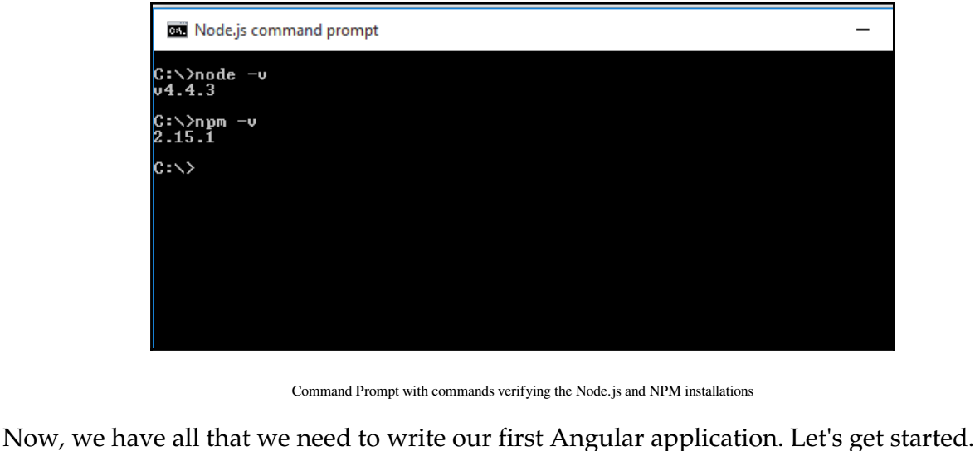
Installing Node.js |
To verify that the installation of Node.js and NPM is successful, follow these steps:
Open Windows Command Prompt, type the node -v command, and run it. You will get the version of Node.js that we installed.
Now, check whether NPM is installed along with Node.js. Run the NPM -v command, and you will get the version number of NPM that is installed.

Slide 38
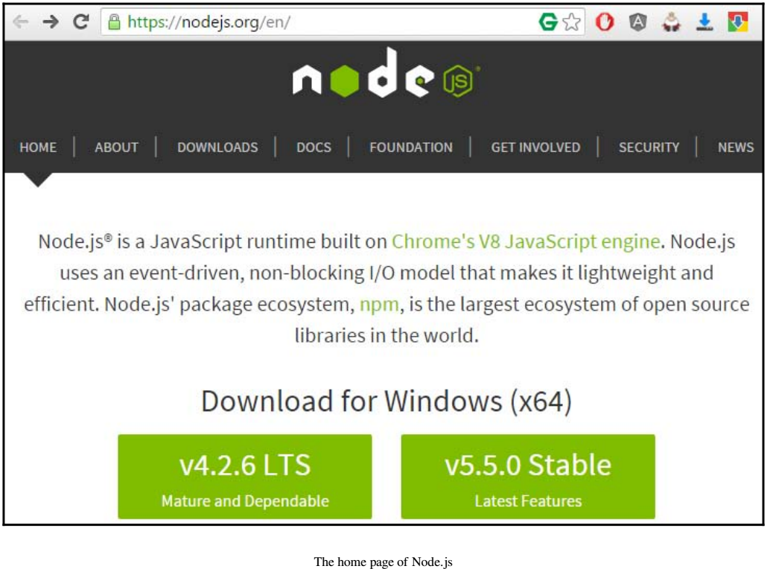
Figure 1-5

Slide 39
Creating an Angular Application
Having installed Node.js, NPM, and Visual Studio Code we are ready to use them for development.
Let's create an Angular application by cloning the git repository with the following steps:
Open Node.Js Command Prompt and execute the following command:
This command will clone the Angular quickstart repository and create an Angular application named my-angular for you with all the boilerplate codes required.
Open the my-angular cloned application using Visual Studio Code – Figure 1-7
The folder structure and the boilerplate code are organized according to the official style guide at https://angular.io/docs/ts/latest/guide/style-guide.html.
The src folder has the code files related to application logic, and the e2e folder has the files related to end-to-end testing.
Let's only focus on package.json for now.

Slide 40
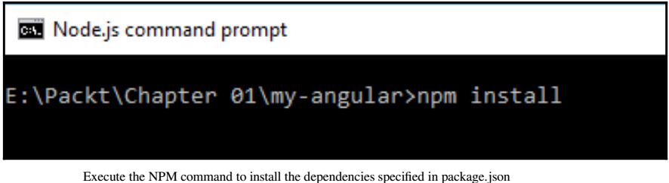

Creating an Angular Application |
Click the package.json file; it will have the details about the configurations of the metadata and project dependencies.
The content of the package.json file is shown in Figure 1-8.
Now, we need to run the NPM install command in the command window by navigating to the application folder to install the required dependencies specified in package.json:
Now, we have all the dependencies added to the project under the node_modules folder: Figure 1-9.
Now, let's run this application. To run it, execute the following command in the command window:

Slide 41
Creating an Angular Application ||
Open any browser and navigate to http://localhost:3000/; you will find the following page, which is rendered through our Angular application, displayed (Figure 1-10).
Running this command builds the application, starts the lite-server, and hosts the application on it.

Slide 42
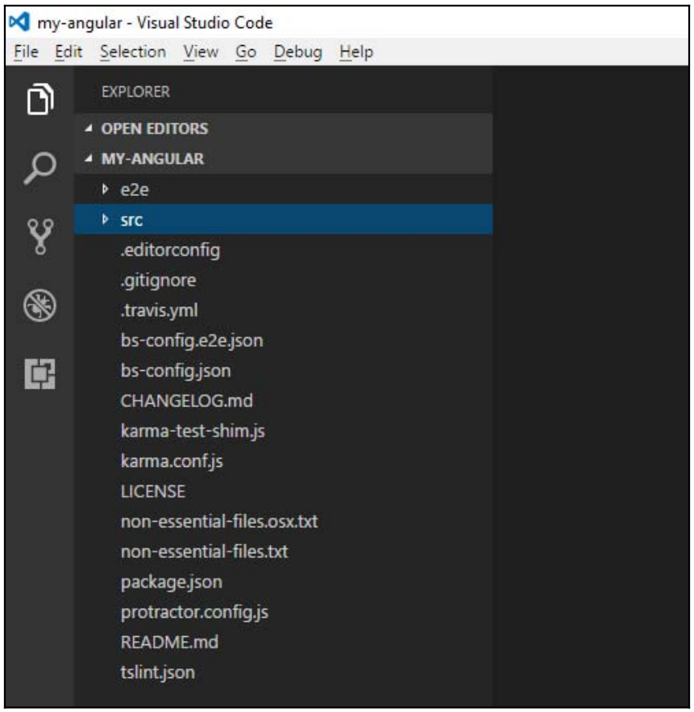
Fig 1-7

Slide 43
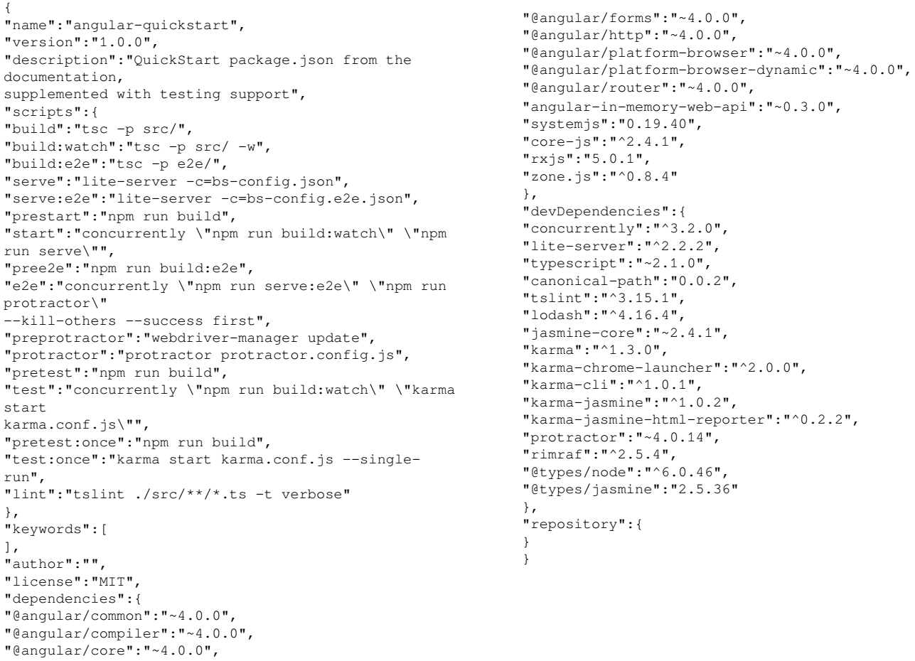
Fig 1-8

Slide 44
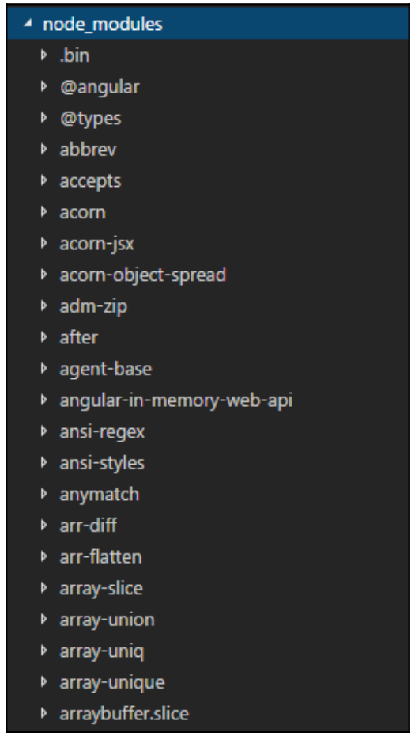
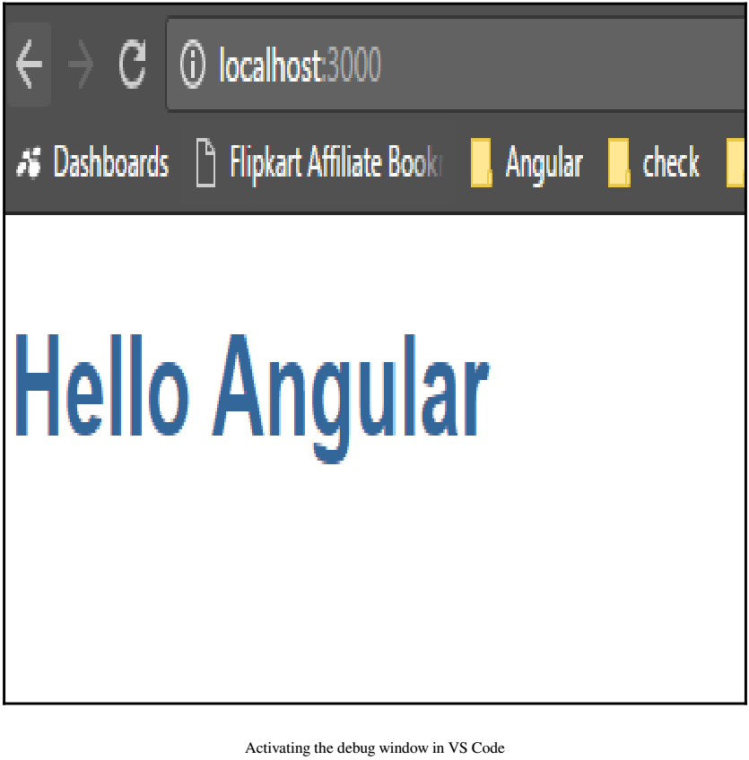
Fig 1-9 || 1-10

Slide 45
index.html
Let's now walk through the content of index.html.
The Figure 1-11 shows is the content of index.html.
So far, we have seen how to create an Angular application by cloning the official QuickStart repository from GitHub.
We will cover the steps to create Angular applications in detail in the upcoming chapters.
Note that the scripts are loaded using System.js.
System.js is the module loader that loads the modules during runtime.

Slide 46
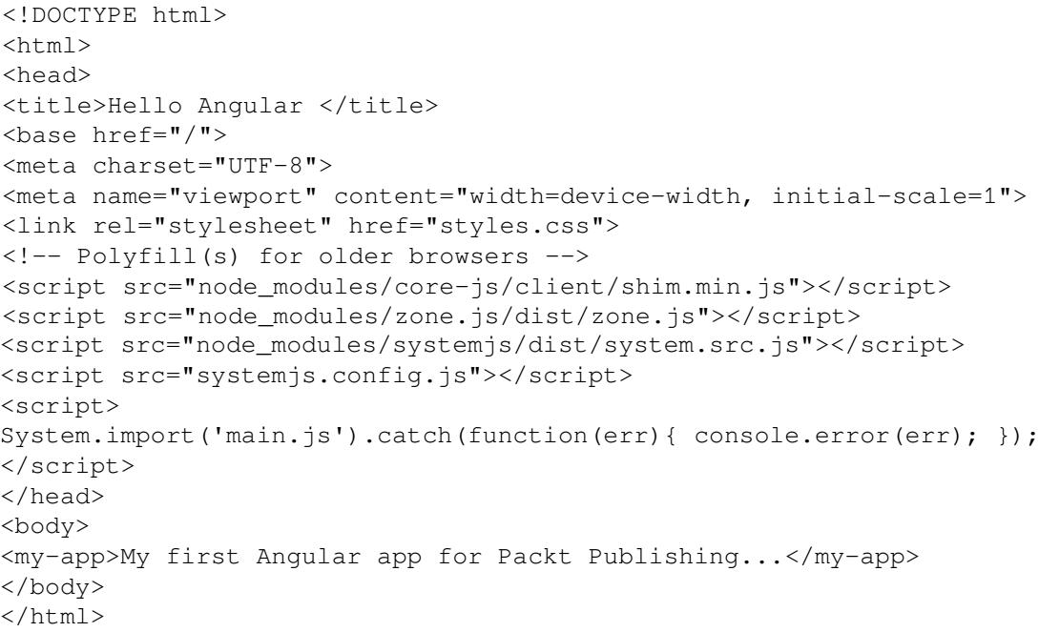
Fig 1-11

Slide 47
The Architecture of Angular
The architecture of Angular comprises of eight core building blocks:
Module Component Template Metadata
Data Binding Service Directive Dependency injection
An Angular application normally starts with the designing of templates with Angular tags or markups.
Then, we write components to handle the templates.
The application-specific logic will be added to services.
Finally, the starting component or root component will be passed on to the Angular bootstrapper.
When we run the application, Angular takes the responsibility of presenting the template to the browser and takes care of user interactions with the elements in the template according to the logic provided in the components and directives.

Slide 48
Angular Blocks: Objective
The objective of each block of Angular is as follows:
Any Angular application will be comprised of a collection of components.
Services will be injected into components.
Templates are responsible for rendering the components in the form of HTML.
Components hold an application logic that supports the views or templates.
Angular itself is a collection of modules.
In Angular 1, the main module or application module is bootstrapped using the ng-app directive.
We can include other lists of modules that our application module or main module is dependent on
they will be defined in the empty array in angular.module('myApp', [ ])
Angular uses ES6 modules, and the functions or variables defined in modules should be exported explicitly to be consumed in other modules.
The exported functions or variables are made available in other modules using the import keyword followed by the function name and then a from keyword followed by the module name.

Slide 49
Angular Blocks: Objective |
For example
Each Angular library is a facade of many private modules that are logically related.
Directives provide instructions to render the templates.

Slide 50
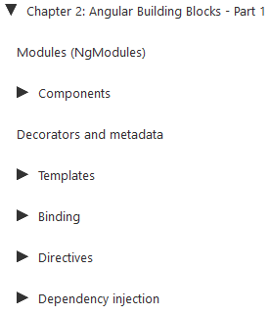
2
Angular Building Blocks - I

Slide 51
Intro
This chapter gives you a detailed walk through the core building blocks of the Angular architecture.
In this chapter, we will cover the following topics:
Modules
Components
Decorators and metadata
Templates
Bindings
Directives
Dependency injection

Slide 52
Modules (NgModules)
A module is a single unit of implementation of distinct functionalities.
Collections of such modules will be used to implement complex applications.
Implementing module patterns helps you avoid global collisions of variables and methods.
JavaScript encapsulates both private and public methods under a single object by implementing a modular pattern.
The modular pattern achieves encapsulation using closure in JavaScript.
JavaScript doesn't support access modifiers
however, the same effect can be achieved using function scopes.
All Angular applications are modular in nature.
We develop Angular applications by creating many modules.
We develop modules to encapsulate functionalities that are independent and have one responsibility.
A module exports the classes available in that module.

Slide 53
Modules (NgModules) |
Angular modules are called as NgModules.
At least one Angular module will be present in any Angular application:
a root module, which will represented as AppModule
AppModule is a class decorated with @NgModule

Slide 54
AppModule Class
The code snippet in Figure 2-1 shows an AppModule class:
In the preceding code, an NgModule imported from @angular/core is decorated to the AppModule class.
NgModule has some important properties, such as
Imports
Exports
Providers
Declarations
Bootstrap
The metadata declarations should be assigned with view classes such as
Components
Directives
Pipes
that belong to this module

Slide 55
AppModule Class |
The metadata exports will be assigned with the
Components
Directives
Pipes
that are usable in the component templates
The metadata imports should be assigned with the exported classes that are used by component templates.
The metadata providers will be assigned with the services that are used or accessed in the entire application.
It creates the instance of services assigned and adds to the global collection of services so that the services will be ready to be consumed across the Angular application.
The metadata bootstrap is assigned with the root component that is responsible to render the main view of the application.

Slide 56
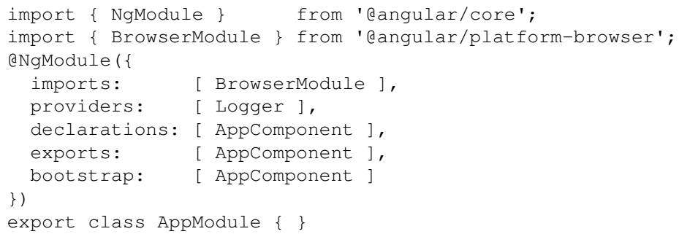
Figure 2-1

Slide 57
AppComponent Class
A sample AppComponent class is shown in Figure 2-2.
The export statement exposes the component, and the AppComponent class is accessible to other modules in the application:
A class is a template that contains definitions of methods and variables of an object.
An object is an instance of the class, so it can hold the real value of the variables, and the methods can perform actions against the actual values.
The current version of JavaScript doesn't support classes. It's a class-free language. In JavaScript, everything is an object, and functions are used to mimic classes.
ECMAScript 6 introduces syntactic sugar over JavaScript prototype-based inheritance by introducing classes to JavaScript.
Here, we leverage the power of TypeScript as a superset of JavaScript.
The export keyword in the statement says that we are exporting or exposing an AppComponent class to other modules of the application.

Slide 58

Figure 2-2

Slide 59
AppComponent Class Access
Let's consider that we have saved this component in a file named app.component.ts.
In order to access or reference the AppComponent class that is exposed, we need to import it in the file we will access.
The following statement does this:
Here, the import keyword in the statement means that we are importing a class that is exposed: AppComponent.
The from keyword represents or refers to the file or module where the importing component exists. For example, it is app.component.ts in our case.
A module name is the filename of the component without the extension; so, here the module name is app.component.
We start the module's filename with the relative file path (./), and it represents the same folder.
Modules can also have a collection of other modules and such modules are known as library modules. Angular itself has many library modules. Some library modules are core, common, router, and so on.
We import Component from the @angular/core library module, which is the primary module that we use for most things:
All Angular library modules will be mentioned without any relative file path in the from clause.

Slide 60

Components
AngularJS has controllers, scopes, and directives to deal with views, bind data, and respond to events by updating changes to data.
In Angular, Components replaced controllers, scopes, and directives from AngularJS.
Angular, introduced components that support the object-oriented component model to write cleaner code.
A component is a simple class that holds the logic of managing the associated template or view.
A simple component class is given as follows:
In a component class, we will expose properties and methods to a template or view.
Component properties can provide data for a template or view and allow the user to modify property values.
Component methods can be called according to user actions over the view.

Slide 61
Annotations
As you can see in Figure 2-3, the code snippet creates a simple JavaScript class named FirstComponent.
You may be wondering how a JavaScript plain class can be treated as a component and how a template can be wired up to this class.
In order to achieve this, Angular leverages the syntax of TypeScript to annotate the FirstComponent class as per ES6 specification 2015.
The code in Figure 2-4 shows the component class with an annotation that declares the class as a component and wires up the template with the markup identifier in the selector.
There is also another metadata named template that defines the inline template that has the HTML snippet for the view or template.
The inline markup will access the properties and methods defined in the component.
So here, the inline view will access the getGreetingPhrase( ) function to fetch and display the phrase to greet, and it will also access the name property to display the name.
The @Component( ) preceding the FirstComponent class is the annotation that denotes this class is a Component, and the markup identifier first component for this component is assigned to the metadata of @Component named selector.

Slide 62
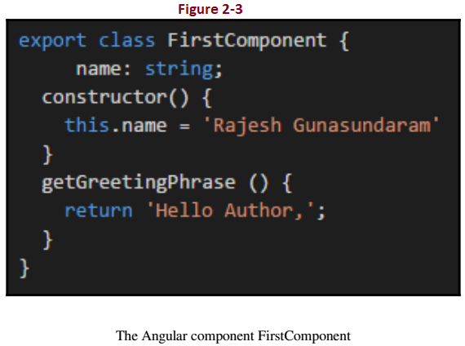
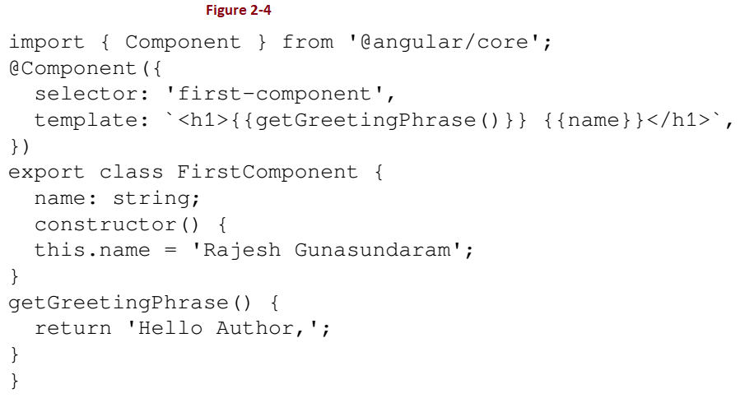
Figure 2-3 || 2-4

Slide 63
Scope
You might be surprised to see that we have not used $scope to expose the property and method of FirstComponent.
Here, our component gets instantiated and is available in the template or view.
So, we can access any property of that instance; also, we can call methods in the instance according to user actions or input in the view or template.
The component instance provides the encapsulated data pertaining to that instance that is similar to the isolated scope in AngularJS.
Inheritance of components can happen in Angular when the template of the root component has the special tags of another component's selector, and this also enables the child component to access its parents and siblings, Figure 2-5.

Slide 64
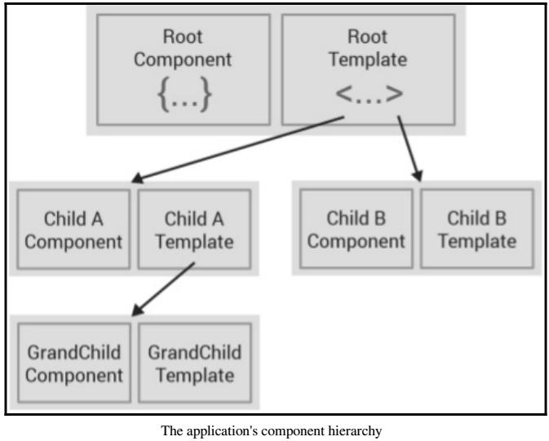
Figure 2-5

Slide 65
The life cycle of a component
Angular manages the life cycle of a component.
Angular takes care of creating and rendering the components and their children and destroying them before removing them from the DOM.
Angular keeps track of the value of the component property value.
The following are the life cycle events of an Angular component given in calling order:
OnChanges: This event is fired when a binding values changes.
This method will have access to both the old value and the new value.
OnInit: This event is fired after the execution of the OnChanges event due to binding value changes.
DoCheck: This event is fired for every change detected, and developers can write custom logic to check for the property changed.
AfterContentInit: This event will be fired when the directive's content has been completely initialized.
AfterContentChecked: This event will be fired after a directive's content has been checked.
AfterViewInit: This event will be fired when the component's template has been completely initialized.
AfterViewChecked: This event will be fired after the component's template has been checked.

Slide 66
The life cycle of a component |
OnDestroy: This event will be fired before destroying the directive or component.
You can either implement all of these events or only the specific events that are required for your component.

Slide 67

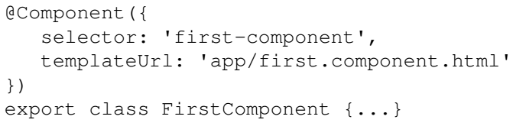
Decorators and metadata
As you saw in the last section, we define JavaScript plain classes for a component, and we annotate it with some information to inform the Angular framework that this class is a component.
We leverage the Typescript syntax and attach the classes with metadata using the decorator feature.
To make a class as a component, we add the @Component decorator, as shown in the following code:
Now, let's attach metadata to the FirstComponent class using the decorator syntax:

Slide 68
Metadata
Here, we have added metadata, such as a selector and templateUrl.
The selector metadata configured in the component tells Angular to create the instance of a component when it encounters the <first-controller> markup:
The templateUrl provides a URL of the template file for the component to render.
When you run the application, the <first-controller> tag will be replaced by the content of the template that is referred to in templateUrl.
This metadata is actually a parameter to the @Component decorator, and the decorator is a function.
By adding metadata via decorators, we are actually telling Angular what to do with the defined class.
The component, template, and metadata together constitute a view.

Slide 69
Templates
You will have noted that we have added inline markups for a view or template when annotating the component.
We can also add a template URL isolating the view, or template markups in a separate HTML file, instead of having it as an inline view or template.
A template comprises HTML tags that provide information to Angular on rendering the components.
A simple template content is given in the following lines of code.
It renders the name of the book and publisher:

Slide 70
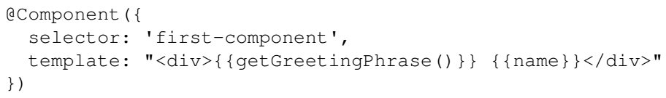
Inline templates
An inline template is used when there is a need to render very simple content, such as a one-liner, for example.
In such cases, inline views or templates will be defined directly in the annotation:

Slide 71
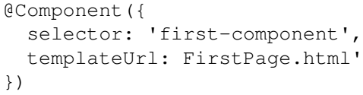
Isolated templates
Isolated templates are used mostly when the template contains more contents.
In such cases, rather than assigning the larger content as an inline view, the content will be moved to a separate file and the HTML file URL will be assigned to templateUrl, as follows:

Slide 72

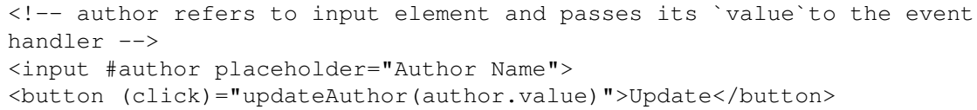
The local template variable
Angular permits creating template-scoped variables to move data across the elements in a template:
In the preceding template markup, we have declared a local variable, todo, using the let keyword.
Then, we iterate through the collection variable todos; each todo item gets assigned to todo and is available for use in <todo-item>.
A local template variable can also be used to hold the DOM element.
The following code shows that the author will hold the input element itself, and the value of the element can be accessed using author.value:

Slide 73
Binding
The binding technique will enable you to bind data to a template and will allow users to interact with the bound data.
The Angular binding framework takes care of rendering the data to a view and updating it as per user actions over the view.
The Figure 2-6 gives you a quick glimpse of the various binding techniques in Angular.
We will go through each binding technique in detail.

Slide 74
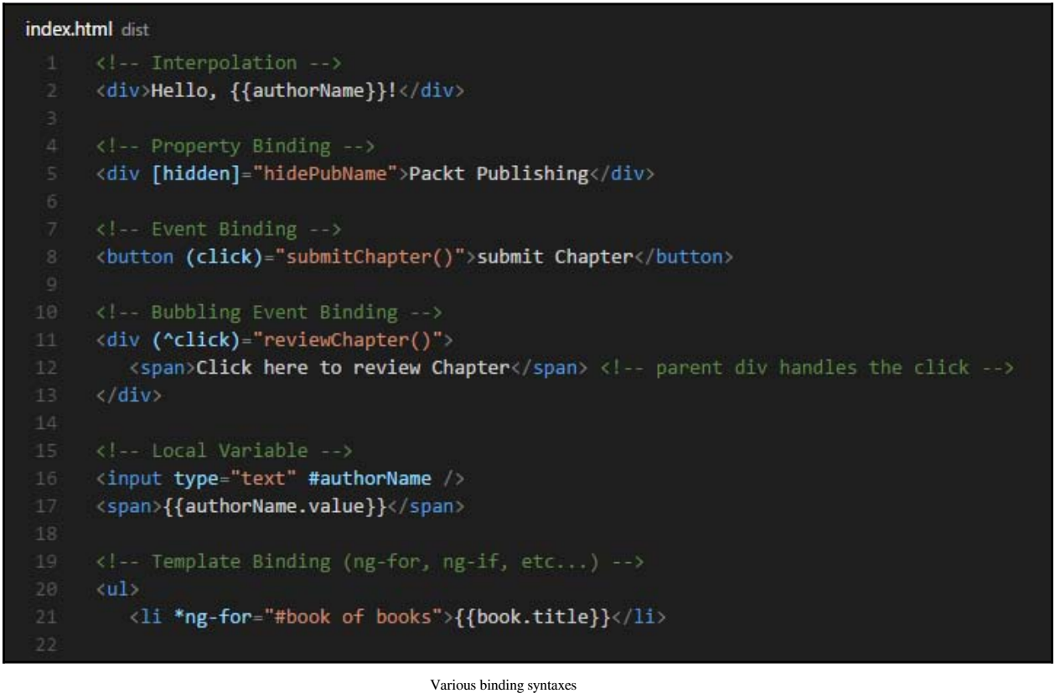
Figure 2-6

Slide 75
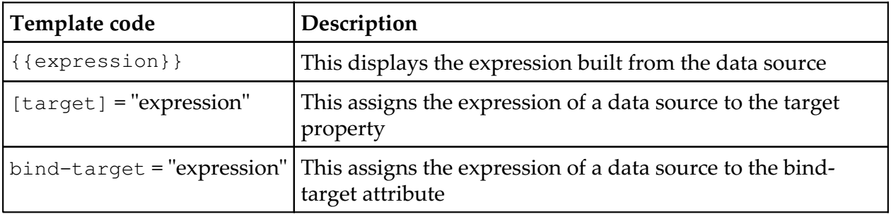
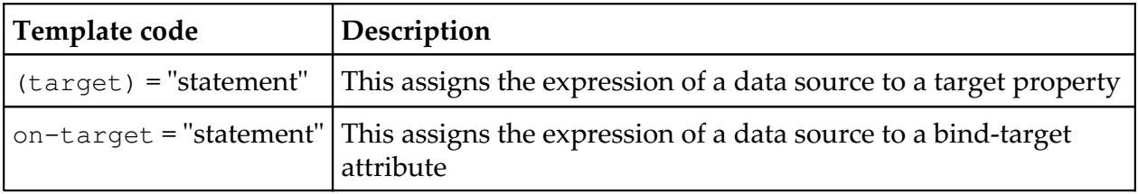
One-way binding
Binding types such as Interpolation, Property, Attribute, Class, and Style support one-way data flow from the data source (exposed from the component) to a view or template.
Template markups that let the data flow from a component property or method to a template are given in the following table (one-way binding):
Template markups that let data flow from a template to a component property or method are given in the following table (one-way binding):

Slide 76
Interpolation binding
Interpolation is one of the main features of Angular.
You can interpolate any property value or expression to the content of any HTML element, such as div and li.
You can achieve this with the help of double-curly braces, {{and}}, as shown in the following line of code:
Here, we interpolate authorName to the content of the div tag.
This is a one-way binding where the data flows from the component property or method to the template.

Slide 77
Property binding
Property binding is used to bind a component property to an HTML element property:
The preceding code snippet binds the hidePubName component property to the div property hidden.
This is also a one-way binding where the data flows from a component property to a template.

Slide 78
Event binding
HTML elements have various DOM events that will be fired when an event is triggered.
For example, a button will fire a click event when it is clicked on.
We hook an event listener to get notified whenever an event is fired:
The preceding Angular code snippet that wraps the event name in brackets needs to hook the event listener so that it gets called when a click event is fired.

Slide 79
Two-way binding
Angular has removed a core feature from its framework, which was one main reason for the birth of AngularJS, that is, two-way binding. So, two way binding is not available by default.
Now, let's see how to implement a two-way binding in Angular.
Angular combined property and event binding for us to implement two-way binding, as shown in the following line of code:
The code snippet shows that ngModel is wrapped with parentheses and then with square brackets.
The parentheses indicate that the component property is tied up with the ngChange event, and the square brackets indicate that the component property is assigned to a value property of the input element.
So, when the value of the input element changes, it fires up the change event that eventually updates authorName with the new value from the event object.
ngModel in the markup is the built-in directive in Angular that unifies property and event binding.
Template markup that helps data flow in both ways, from a template to a component and from a component to a template, is given in the Figure 2-7 (two-way binding):

Slide 80
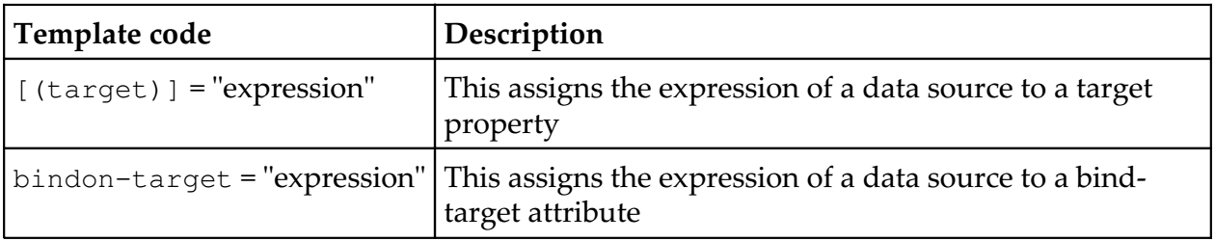
Figure 2-7

Slide 81
Directives
We walked through the Angular component and the way it is decorated.
The @Component itself is a directive with a template configured in the metadata.
So, a directive is a component without a template, and @directive is used in Typescript to attach metadata to it.

Slide 82
Structural directives
Structural directives deal with modifying elements in the DOM by
adding new elements
removing existing elements
replacing existing elements with new elements
The following markup shows two structural directives: *ngFor and *ngIf:
*ngFor iterates through each item in the todos collection and adds a div tag for each item.
And *ngIf renders <todo-item> only if selectedTodo is available.

Slide 83
Attribute directives
An attribute directive will be added like an attribute to existing HTML elements, and this can alter or extend the behavior of HTML elements.
For example, an ngModel directive, if added to an input element, will extend it by updating its value property and also by responding to change events:
We can also write our own directives apart from using existing ones, such as
ngSwitch
ngStyles
ngClass

Slide 84
Dependency Injection
Dependency injection is a design pattern that
handles dependencies
resolves them
An instance of the dependencies will be passed to the dependent in order to use it.
If a client module or class is dependent on a service, it needs to create an instance of the service before using it.
We can inject or pass the instance of the service to the client using a dependency injection pattern, rather than a client module building the service.
Applying dependency injection enables us to create a client that does not have any knowledge
of the service to be built
of the actual service it is consuming
The client will only have knowledge about the interface of the service as it needs to know how to use the service.

Slide 85
Why dependency injection?
Consider that we are creating a Mobile class: Figure 2-8, and it has dependency on
a camera
internet connectivity
In the preceding code snippet, you can see that the instances of Camera and Internet are created in the constructor of the Mobile class.
These are the features of Mobile.
Instead of requesting for the feature, the Mobile class created the feature by itself.
This means that the Mobile class is bound to a certain version of features, such as a 2 MP camera and 2G Internet.
Later, if we want to upgrade the camera to 20 MP and Internet to 3G or 4G, we need to rewrite the code of the Mobile class.
The Mobile class is dependent on Camera and Internet, and this increases the difficulty in testing.
We can only test Mobile with 2G Internet and 2 MP Camera because we cannot control the dependencies as the Mobile class takes care of the instance of dependency by itself.

Slide 86
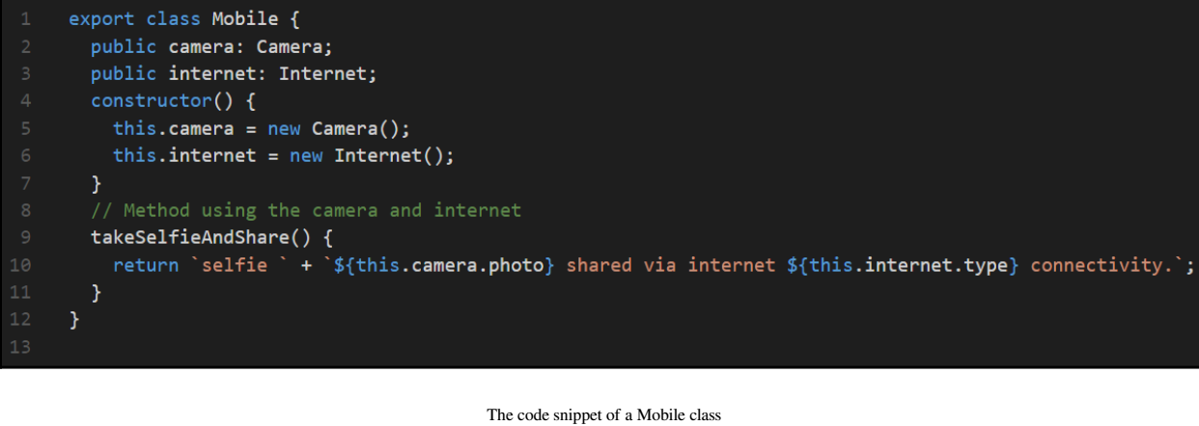
Figure 2-8

Slide 87
Decoupling
Now, let's modify the constructor to receive the instance of Camera and Internet as parameters, as shown in the following line of code:
Now the Mobile class will not create an instance of Camera or Internet.
It just consumes the instance of Camera or Internet that is received from the constructor parameters.
This means that we moved the dependencies to the constructor.
The client can create a Mobile class by passing the instance of Camera and Internet to the constructor, as shown in the following code snippet:
As you can see, the definitions of Camera and Internet have been decoupled from the Mobile class.
We can pass any type of Camera with various megapixels and Internet with various bandwidths, such as 2G, 3G, and 4G, as long as both the Camera and Internet types passed by the client comply with the interface of Camera and Internet:

Slide 88
Decoupling |
There is no change in the Mobile class to accommodate the 20 MP Camera and 4G Internet dependencies.
The Mobile class is much easier to test with various combinations of Camera and Internet, as we have complete control over the dependencies.
We can also use a mocking technique in testing and pass mocks of Camera and Internet to constructor so that all the necessary operations will be done against the mocks of Camera and Internet.

Slide 89
The role of injectors
We just got to know what a dependency injection is and how it receives dependencies from an external client rather than creating them itself.
However, the client needs to update its code to pass an instance of 20 MP Camera and 4G Internet dependencies.
Any client that wants to consume the Mobile class must create instances of Camera and Internet as the Mobile class depends on them.
We eliminated the responsibility for creating the instances of dependencies from the Mobile class and moved them to clients that will consume the Mobile class.
Now, it has become the poor client's problem to create the instances of Camera and Internet.
So, to reduce the extra efforts of a client in creating the instances of dependencies, we need injectors that take care of assembling instances of the required Camera and Internet for the client.
The dependency injection framework has something called an injector where we register our classes, such as Mobile.
We can then request the injector to create the instance of Mobile for us.
The injector will then take care of resolving the dependencies and creating mobile, as shown in the following line of code:

Slide 90
Handling dependency injection in Angular
Angular has its own dependency injection framework, and we will see, with an example, how it handles dependency injection.
First, we will create a Todo class under app/todos/todo.ts with properties such as id, description, and isCompleted, as given in the following screenshot: Figure 2-9.
Then, create a TodoListComponent component: Figure 2-10 and add the property to hold the collection of todo items retrieved from the injected TodoService.
The service will be injected into constructor when TodoListComponent is instantiated by the dependency injection framework.
You will learn more about services in chapter 3, Angular Building Blocks - Part 2.
The code is written using Typescript, and when it compiles the code to JavaScript, it includes information about the class metadata, as the class was decorated with @component.
This class metadata holds the information about associating the todoService parameter with the TodoService class.
This enables the Angular injector to inject the instance of TodoService when it creates a new TodoListComponent.

Slide 91
Handling dependency injection in Angular |
We don't explicitly call an injector to inject the service in our code.
Instead, Angular's automated dependency injection takes care of it.
The injector will be called implicitly while Angular instantiates components when it encounters the <todo-list> selector through HTML markups or when navigating to a component via a router.

Slide 92
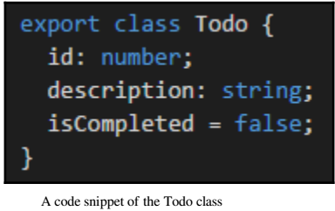
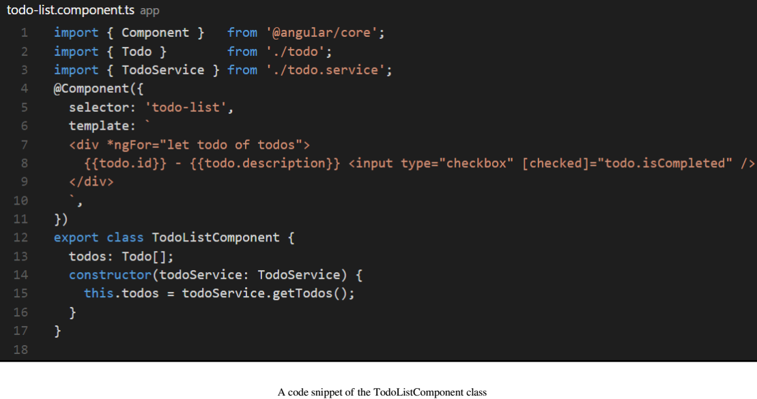
Figure 2-9 || 2-10

Slide 93
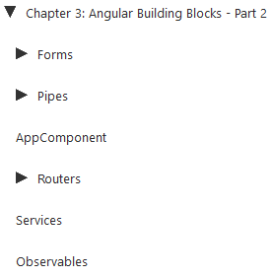
3
Angular Building Blocks - II

Slide 94
Intro
This chapter gives you a detailed walk-through on the remaining uncovered core building blocks of the Angular architecture.
In this chapter, we will cover the following topics:
Forms
Pipes
Router
Services
Observables

Slide 95
Forms
Every application has a data entry point where it enables end users to input data.
Forms are meant to insert or update input data to a server and on a page.
Input data should be validated before it is submitted for further action.
There are two types of validation methods applied:
client-side validation
server-side validation
Angular has classes such as
FormBuilder
Control
Validators
to handle forms.
It enables you to easily set validation rules using Control and Validators.

Slide 96
Server-side validation
Server-side validations will be handled by the server.
The information received will be processed and validated by the server.
It is necessary to update the UI with appropriate information if there are any errors in submitting the form.
If the information is invalid or not sufficient, then the appropriate response will be sent back to the client.
This approach to validation is more secure as it works even if JavaScript is turned off in the browser and also, malicious users can't bypass the server-side validation.
However, the drawback of this approach is that the form will be validated only after submitting it to the server.
So, the user has to wait until the form is fully submitted to the server in order to know whether all the data supplied is valid.

Slide 97
Client-side validation
Though server-side validation is more secure, it will not provide a better user experience.
Client-side validations are implemented using a scripting language such as JavaScript, and the validations will be done on the client itself.
The user input data can be validated as and when keyed in by the user.
This leads to a richer experience by providing immediate response with validation errors on the screen.
The user need not wait for the entire form to be submitted to know whether the data entered is valid.

Slide 98
Tools for forms
Angular has various tools to achieve the preceding scenarios to implement forms in our application.
The following are such tools and their respective purposes:
Controls: These provide objects by encapsulating the inputs of forms
Validators: These help in validating the input data from forms
Observers: These help keep track of changes in forms and informs the user of any validation errors

Slide 99
Types of Angular forms
Angular provides two approaches for handling forms:
template-driven forms
Model-driven forms

Slide 100
Template driven forms
AngularJS handled forms using the ng-model directive, and it leveraged the power of two-way binding that made the lives of developers easier.
Angular enables developers to build template-driven forms using ngModel, which is similar to ng-model in AngularJS.
The following is the implementation of template-driven forms:
Let's create an app named First Template Form in Visual Studio Code (VS Code).
Add the required packages and dependency details in package.json, and install them using the npm install command.
Create a class book and add the following code snippet: Code 3-1.
Create AppComponent and add the following code: Code 3-2.
This AppComponent shown earlier is the root component of the application that will host the BookFormComponent.
AppComponent is decorated with the first-template-form selector and template that has the inline HTML with the <book-form/> special tag.
This tag will be updated with the actual template during runtime.

Slide 101
Template driven forms |
Now, let's add the book-form.component.ts with the following code snippet: Code 3-3.
Here, note that we have imported Book from book.ts.
Book is the data model for this form.
BookFormComponent is decorated with the @Component directive that was imported from @angular/core.
Selector value is set to book-form and the templateUrl is assigned with the template HTML file.
In the BookFormCompoent, we have instantiated Book model with the dummy data.
We have two methods--onSubmit( ) and newBook( )--one to post the data submitted to API and the other to clear the form.
Now, let's add the book-form.component.html template file to the following HTML content: Code 3-4.
(Page 49).

Slide 102
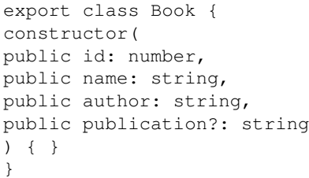
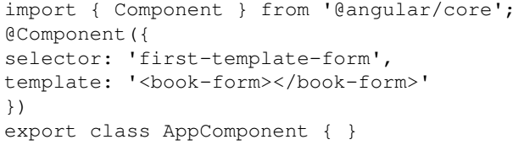
Code 3-1 || 3-2

Slide 103
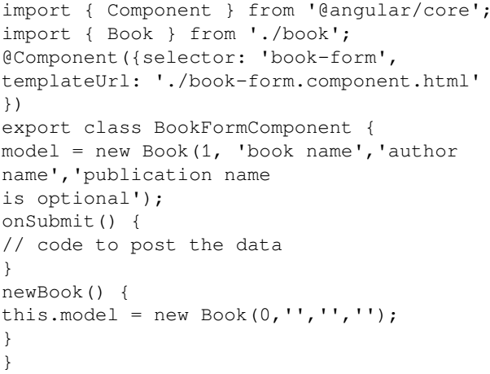
Code 3-3

Slide 104
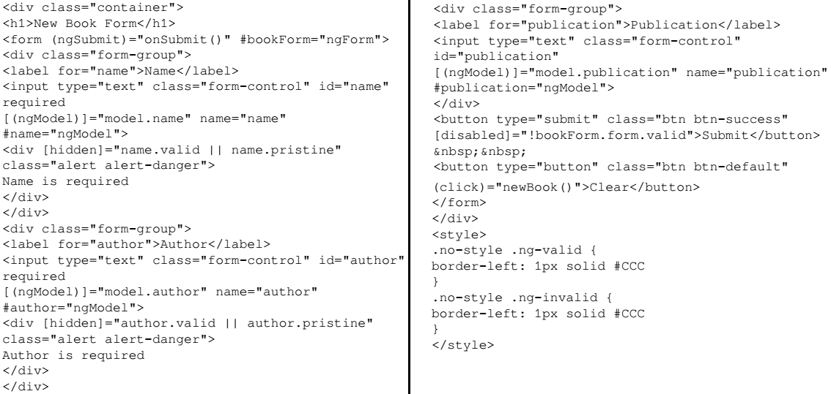
Code 3-4

Slide 105
Model-driven forms
Angular provides the FormGroup and FormControl attributes to implement model-driven forms.
(Page 55).

Slide 106
Pipes
Pipes in Angular are a replacement of filters in AngularJS 1.x.
Pipes are an improved version of filters that transform common data.
Most of the applications fetch data from a server and transform it before displaying the data on the frontend.
In such cases, pipes are very useful in transforming the data on rendering the template.
Angular provides these cool API pipes for this purpose.
Pipes take data as input and output transformed data as needed.

Slide 107
Common pipes
The following are the built-in pipes available in @angular/core, and we will see a few pipes with examples:
AsyncPipe
CurrencyPipe
DatePipe
DecimalPipe
I18nPluralPipe
I18nSelectPipe
JsonPipe
LowerCasePipe
PercentPipe
SlicePipe
TitleCasePipe
UpperCasePipe

Slide 108
Pipe with parameters
We can pass parameters to a pipe followed by a colon (:) symbol, as follows:
Multiple inputs to a pipe can be added by separating the values by (:), as shown:

Slide 109
Chaining pipes
In some scenarios, it may be necessary to use more than one pipe.
For example, consider a scenario to display data in uppercase, long formatted date.
The following code displays the publishing date of a book in uppercase and in long formatted date:

Slide 110
AppComponent
AppComponent is the component of an application that is configured as root component, and it handles the rendering of the app.component.html template.
In the preceding sections, we saw the template code that implemented various pipes and their respective output.
The following code snippet shows the component for the template: Code 3A-1.
Pipes are very powerful and simple-to-use APIs provided by Angular, ease our process of formatting data before displaying it on the screen.

Slide 111
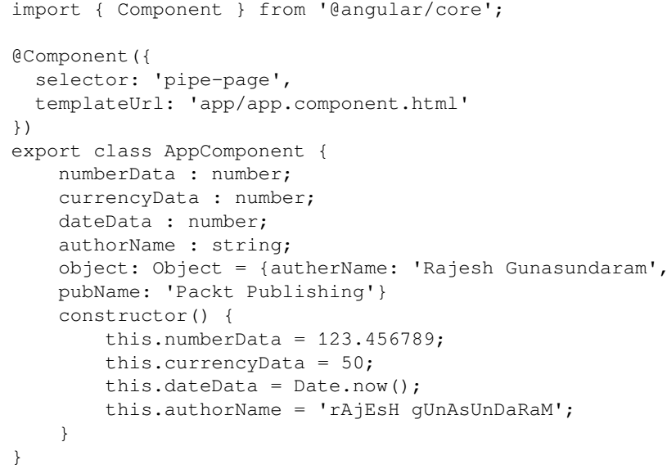
Code 3A-1

Slide 112
Routers
AngularJS used the ngRoute module to run simple routers with basic features.
It enables deep linking of URLs to components and views by mapping the path to the routes configured using the $routeProvider service.
AngularJS 1.x needs the ngRoute module to be installed to implement routing in an application.
Angular introduced a Component Router that
deep links the URL request
navigates to the template or view
It passes parameters, if any, to the respective component that is annotated for this route.

Slide 113
The core concept of Component Routers
Angular uses a Component Router for a view system.
It also works on AngularJS 1.x.
It supports
intercepting routes and providing route-specific values to the loaded component
automatic deep linking
Nested
sibling routes
Let's go through some of the core features of Component Routers.

Slide 114
Setting up a Component Router
A Component Router is not part of the core Angular framework.
It comes as part of the Angular NPM bundle as an individual library, @angular/router.
We need to add @angular/router to the packages.json under the dependencies section.
Then, in the app.routing.ts, we need to import Routes and RouterModule from @angular/router.
The router constitutes directives such as
RouterOutlet
RouterLink
RouterLinkActive,
a service RouterModule
the configuration for Routes.
Then, we need to add the <base> element under <head> to instruct the router to set up navigation URLs.
The following code snippet shows the <base> tag with the href attribute that is to be added to the head tag in the index file, considering that the app folder is the root of the application.

Slide 115
Setting up a Component Router |
This is required when you run your application in HTML5 mode. It helps resolve all the relative URLs in the application:

Slide 116
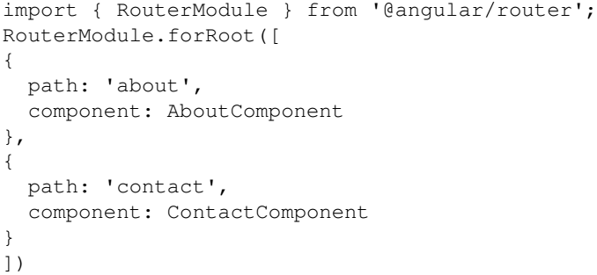
Configuring routes
The routes have information about selecting the view to render when a user clicks on a link for navigation.
The following code snippet shows how to configure routes in app.module.ts:
(Page 71).

Slide 118
Services
The applications we create handle volumes of data.
Most of the data will be retrieved from services and will be reused in various parts of the application.
Let's create a service that can retrieve data using http.
The service should be loosely coupled with components, as the primary focus of the component should be to support the view.
So, the service can be injected to components using a dependency injection.
This approach will enable us to mock the service in order to unit test the component.
Let's create a simple TodoService that returns a list of Todo items.
The code snippet of TodoService is shown here.
TodoService has a property named todos of the type array that can hold a collection of Todo items and is hardcoded with the Todo items in the constructor:

Slide 119
Observables
In AngularJS, we consumed services to retrieve data asynchronously using promises in $http.
In Angular, we have the Http service over $http, and it returns an observable object instead of a promise as it applies a pattern called the analogous pattern.
Angular leverages the Observable class adopted from the ReactiveX library.
ReactiveX is an API for asynchronous programming with Observables that is done by applying
the observer and iterator patterns
functional programming
You can find more information about Reactive programming at http://reactivex.io/.

Slide 120
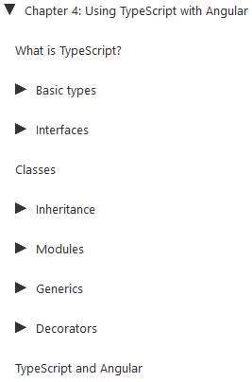
4
Using TypeScript with Angular

Slide 121
Intro
This chapter discusses the fundamentals of TypeScript and the benefits of using TypeScript to write Angular applications.
In this chapter, we will cover the following topics:
What is TypeScript?
Basic types
Interfaces
Classes
Modules
Functions
Generics Decorators
TypeScript and Angular

Slide 122
What is TypeScript?

Slide 123
Basic Types

Slide 124
Interfaces

Slide 125
Classes

Slide 126
Inheritance

Slide 127
Modules

Slide 128
Generics

Slide 129
Decorators

Slide 130
TypeScript and Angular

Slide 131
Angular Development History
Controllers in Angular

Slide 132
Angular Development History
AngularJS was originally developed in 2009 by Miško Hevery at Brat Tech LLC as the software behind an online JSON storage service, that would have been priced by the megabyte, for easy-to-make applications for the enterprise.
This venture was located at the web domain "GetAngular.com", and had a few subscribers, before the two decided to abandon the business idea and release Angular as an open-source library.
The 1.6 release added many of the concepts of Angular to AngularJS, including the concept of a component-based application architecture.
This release among others removed the Sandbox, which many developers believed provided additional security, despite numerous vulnerabilities that had been discovered that bypassed the sandbox.
The current (as of February 2018) stable release of AngularJS is 1.6.9.
In January 2018, a schedule was announced for phasing-out AngularJS: after releasing 1.7.0, the active development on AngularJS will continue till June 30, 2018.
Afterwards, 1.7 will be supported till June 30, 2021 as long-term support.

Slide 133
Angular and AngularDart
Angular 2+ versions are simply called Angular.
Angular is an incompatible rewrite of AngularJS.
It is a TypeScript-based open-source front-end web application platform.
Angular 4 was announced on 13 December 2016, skipping 3 to avoid a confusion due to the misalignment of the router package's version which was already distributed as v3.3.0.
AngularDart works on Dart, which is an object-oriented, class defined, single inheritance using C# style syntax, that is different from Angular JS (which uses JavaScript) and Angular 2/ Angular 4 (which uses TypeScript).
Angular 4 released in March 2017, with the framework's version aligned with the version number of the router it used.
Angular 5 was released on November 1, 2017. Key improvements in Angular 5 include support for progressive Web apps, a build optimizer and improvements related to Material Design
As on: 7 Apr 18

Slide 134
Angular and AngularDart |
Angular 6 release will be pushed back to March or April 2018, with Angular 7 showing up in September/October 2018.
Each version is expected to be backward-compatible with the prior release. Google pledged to do twice-a-year upgrades.

Slide 135
Controllers in Angular
AngularJS has
Controllers
Scopes
Directives
to deal with
Views
bind data
and respond to events by updating changes to data
In Angular, Components replaced
Controllers
Scopes
directives from AngularJS

